Slide 1

Fiscal Patriots Dashboard
Follow the Money
Trust The Recipient
By: Khaled Alkurd, Nikita Chandrasing, Mariam Debas, Pranavi Doodala, Andy Yaro George Mason University Costello College of Business
Fiscal Patriots | AGA Datathon 2026

Slide 2



Meet The Fiscal Patriots
Five analysts. Three datasets. One mission: protect taxpayer dollars.
Khaled Alkurd
Team Lead
[Add photo]
Pranavi Doodala
ML Lead
Mariam Debas
Visualization Lead
• Forensic Accounting • Accounting Analytics • Python • SQL • R • Alteryx • Tableau
• Business Analytics
• Data Science • Python • R
• Accounting
• Data Analytics • Tableau • R ​
[Add photo]
Nikita Chandrasing
Research Lead
[Add photo]
Andy Yaro
Documentation Lead
[Insert key capabilities and areas of expertise]
[Insert key capabilities and areas of expertise]
Fiscal Patriots | AGA Datathon 2026

Slide 3
Can We Trust Where Our Tax Dollars Go?
The Data
The Problem
The Solution
We Connected the Dots
74M USAspending records processed
57,448 audited entities analyzed
3 federal systems integrated
Trust Can't Be Verified
72% of SAM exclusions lack a UEI
Audit failures don't reduce funding
$1.09T to Entities with Severe Audit Failures
We Built the Tools
42,233 entities matches & scored
Taxpayer Protection Score (0-100)
Predictive risk model
Citizens can finally see where tax dollars go
But they can't verify which entities to trust
Until now
Fiscal Patriots | AGA Datathon 2026
Source: USAspending.gov (FY2019-2024), Federal Audit Clearinghouse (FY2016-Present), SAM.gov Public Extract 25361 (Dec 27, 2025)

Slide 4
A Unified View of Federal Accountability
Three federal systems connected by one identifier. Separately, open data. Together, accountability.
USAspending.gov
Federal Audit Clearinghouse
SAM.gov
Federal financial assistance (grants, loans, subsidies)
74M records FY2019-2024
Tracks who receives federal funds
Primary spending data source
Single audit findings and compliance
57,448 entities FY2016-2024
Required for entities receiving $750k+
Identifies control failures
Excluded & debarred entities
Governmentwide exclusions
167,000 records
Public Extract V2 (Dec 27, 2025)
UEI is the key. Connecting spending, audits, and exclusions
Connected by UEI Unique Entity Identifier
Powered by: Alteryx (Data Engineering), Tableau (Visuals), Python (ML)
Fiscal Patriots | AGA Datathon 2026
Source: USAspending.gov (FY2019-2024), Federal Audit Clearinghouse (FY2016-2024), SAM.gov Public Extract 25361 (Dec 27, 2025)

Slide 5
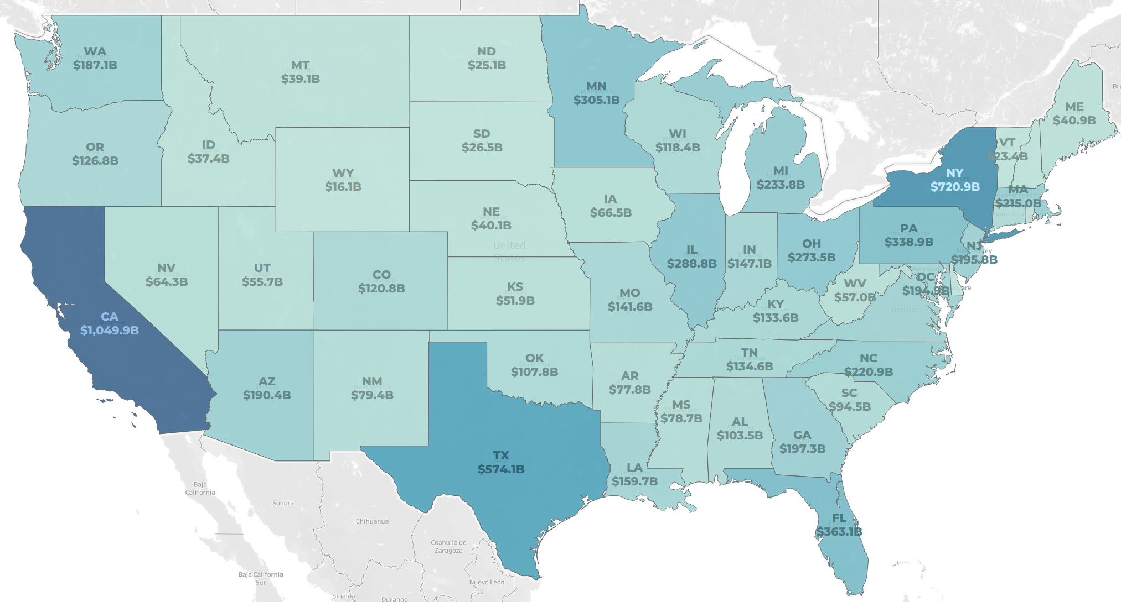
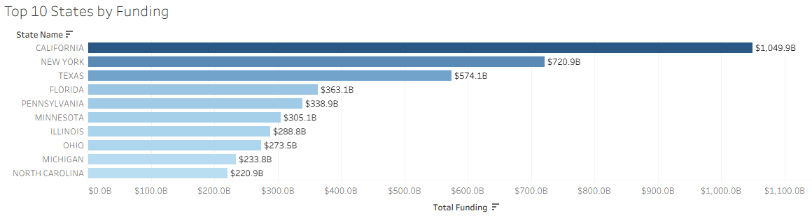
Where Does Federal Funding Go?
Half of all federal assistance flows to just 10 states. This is where the money lands.
Funding Snapshot
$8.58 Trillion Federal Financial Assistance
$4.37T to Top 10 States (51%)
$1.05T to California Alone (12%)
181,922 Recipients Tracked
You can see where the money goes. But can you trust who receives it?
Fiscal Patriots | AGA Datathon 2026
Source: USAspending.gov (FY2019-2024)
Notes:
Mariam -
Over the past six years, the federal government has distributed approximately $8.58 T in financial assistance to almost 182,000 recipients across the country.
But here's what's striking - this map shows funding isn't distributed evenly. Half of all federal assistance - $4.37 trillion - flows to just 10 states. California alone receives over $1 trillion, which is 12% of all federal funding.
Now, when we look at this map, we can see exactly where the money lands. The darker blue states are receiving the most funding. But here's the critical question..." -pause- "...you can see where the money goes, but can you trust who receives it

Slide 6
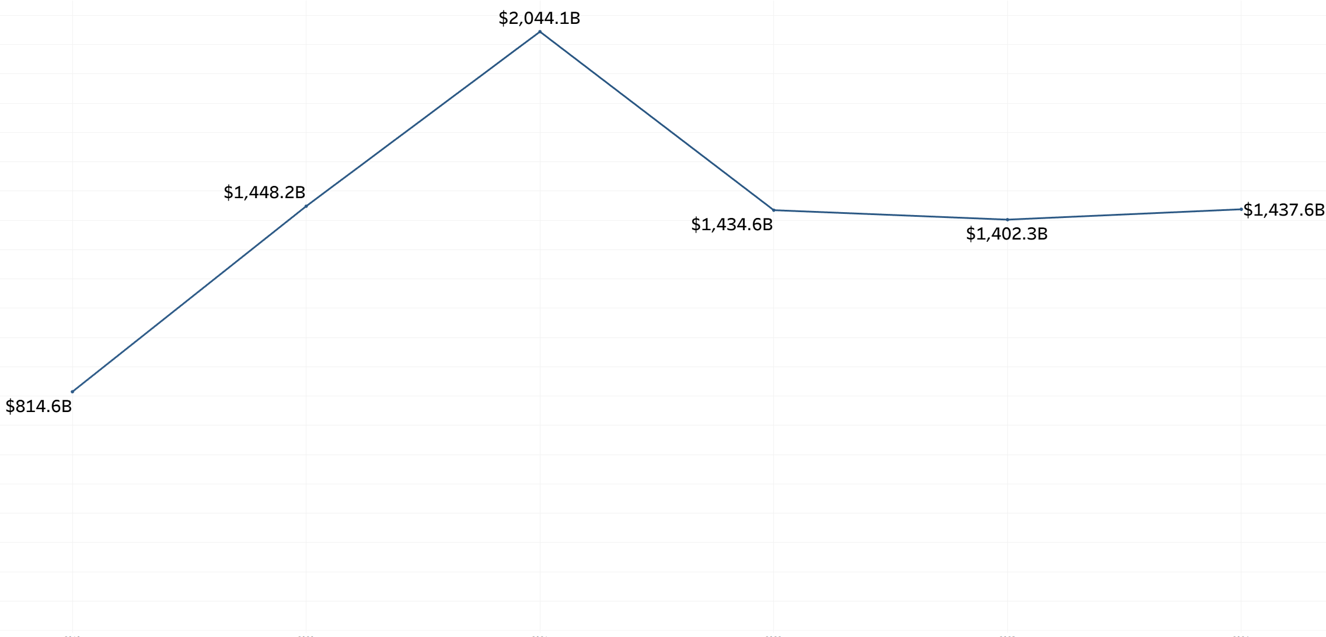
Federal Financial Assistance Over Time
COVID drove funding to record highs. The baseline nearly doubled. Did accountability keep pace?
Trend Snapshot
$2.04 Trillion FY2021 Peak (COVID)
$1.4 Trillion Stabilized by FY2022
3 Years Flat FY2022-2024
$8.58T Total Over 6 Years
+76% in 5 Years
2019
2020
2021
2022
2023
2024
Spending up 76%. Oversight unchanged.
Fiscal Patriots | AGA Datathon 2026
Source: USAspending.gov (FY2019-2024)
Notes:
Mariam -
Now let's look at what happened to federal spending over the past six years. In 2021, at the height of COVID, federal assistance hit an all-time high of $2.04 trillion - that's the spike you see here. PPP loans, CARES Act funding, enhanced unemployment - money was flowing out at unprecedented speed. By 2022, spending stabilized at around $1.4 trillion, and it's stayed flat through 2024.
But here's what should concern every taxpayer …"spending increased 76% in just five years. The federal government nearly doubled the baseline of assistance it provides"
Gap: But oversight? The accountability systems? They didn't change at all. We're still using the same frameworks, the same controls, the same manual processes that existed when spending was half this amount.
Implication: During COVID, agencies had to move fast - speed over scrutiny. Billions went out the door in weeks. And now, years later, we're still finding entities that received massive funding despite having documented control failures

Slide 7
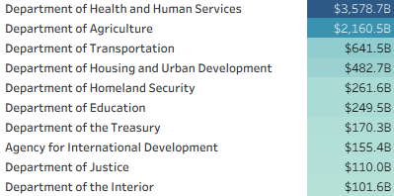
How Is Funding Concentrated?
Just 10 agencies are responsible for 92% of all federal financial assistance to recipients nationwide.
Concentration Snapshot
$3.58 Trillion to HHS Alone (42%)
$5.74T to Top 2 Agencies (67%)
$7.9T to Top 10 Agencies (92%)
$670B to 33 Other Agencies (8%)
Top 10 Agencies by Federal Funding (FY2019-2024)
33 Other Agencies: 8% ($670B)
Top 10 Agencies: 92% ($7.9T)
67% of federal dollars flow through just two agencies. Who's watching where it goes?
Fiscal Patriots | AGA Datathon 2026
Source: USAspending.gov (FY2019-2024)
Notes:
Mariam
Transition - "Now let's look at where all this money is concentrated by agency."
Just 10 agencies are responsible for 92% of all federal financial assistance to recipients nationwide. That's $7.9 trillion out of $8.58 trillion. But it's even more concentrated than that."
The Department of Health and Human Services alone manages $3.58 trillion - that's 42% of all federal funding. HHS is nearly half of all federal assistance."
"When you add USDA - the Department of Agriculture - these two agencies control 67% of federal dollars. Two-thirds of all taxpayer money flows through just two agencies."
You can see it in this pie chart - the top 10 are the blue segments representing 92% of funding. That tiny sliver? That's 33 other federal agencies sharing just 8% - $670 billion."
Implication: Here's why this matters..." [pause, gesture to bottom callout] "...67% of federal dollars flow through just two agencies. So the question becomes: who's watching where it goes?"
Set up the concern: "When funding is this concentrated, accountability failures at HHS or USDA don't just affect one program - they affect trillions in taxpayer dollars."

Slide 8
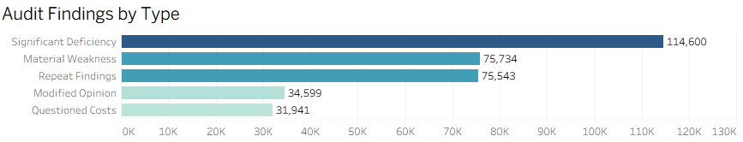
What the Audits Reveal
Cumulative Audit Findings (FY2016-2024) reveal a chronic pattern of over 332,000 findings of control failures and financial mismanagement.
Highest severity: Indicates broken internal controls
Federal Audit Snapshot
57,448 Entities Audited
332,417 Total Findings FY2016-2024
Average of 5.8 Findings per Entity
75,734 Material Weaknesses
What These Findings Mean
Significant Deficiency | Material Weakness | Repeat Findings | Modified Opinion | Questioned Costs
Notable control weakness | Severe control failure | Same issue year after year | Auditor couldn't fully approve | Spending flagged as improper
Audits surface the problems. But how do we measure the risk?
Fiscal Patriots | AGA Datathon 2026
Source: Federal Audit Clearinghouse (FY2016-2024)

Slide 9
The Taxpayer Protection Score
Turning complex audit data into a simple 0-100 score. Making federal accountability accessible to everyone.
Score = 100 - Risk Points (capped 0-100)
Assessment parameter
Risk Factor Rationale
Key Risk Factors
Going Concern (+25) | Auditor doubts entity can continue operating.
Material Weakness (+20) | Severe internal control failure.
Repeat Findings (+15) | Same problem year after year, the entity isn't improving.
Questioned Costs (+15) | Taxpayer dollars flagged as being used improperly.
11 total risk factors weighted by severity (see appendix)
Mitigating Factors
Low Risk Auditee (-15) | Clean audit history, proven track record.
Corrective Action Plan (-5) | Entity responded to findings with an action plan.
Risk Tiers
🔴 High Risk (0-59). Multiple audit failures
🟡 Moderate Risk (60-79). Some concerns identified
🟢 Low Risk (80-100). Minimal findings, trusted
Now let's apply this score to real federal funding data.
Fiscal Patriots | AGA Datathon 2026
Source: Federal Audit Clearinghouse (FY2016-2024) merged with USAspending.gov (FY2019-2024)

Slide 10
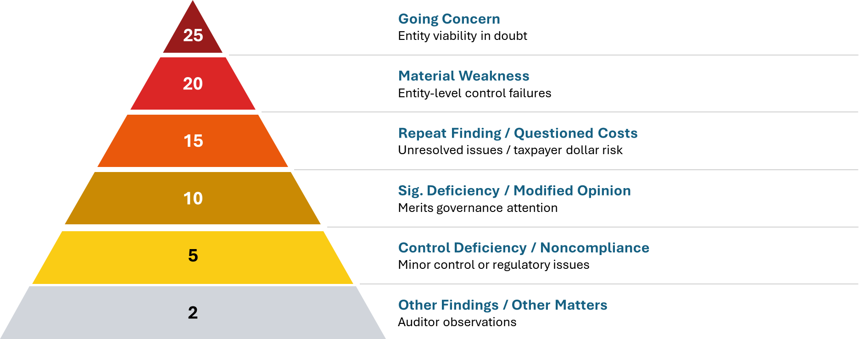
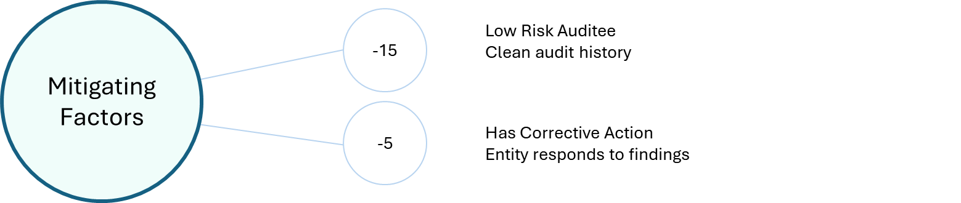
The Science Behind the Score
Federal audit standards define severity. Our model proves they predict risk.
Score = 100 - Risk Points (capped 0-100)
Feature importance bars Horizontal bar chart showing which variables the model ranked highest
Risk Tiers 🟢 80-100 Low Risk 🟡 60-79 Moderate Risk 🔴 0-59 High Risk
Built on Law, Proven by Math: A Transparent Standard for Federal Risk.
Fiscal Patriots | AGA Datathon 2026
Source: 2 CFR 200 Subpart F | GAGAS | SAS 115 | Random Forest Model
Notes:
Why did we take this approach? We combined federal standards with machine learning to create a transparent, defensible score.

Slide 11
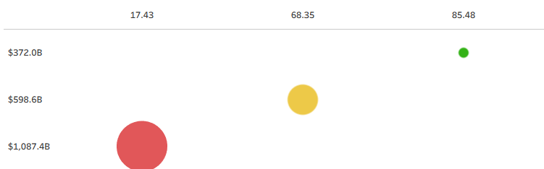
The Funding Paradox: High-Risk Entities Get 3x More
$1.09 trillion in taxpayer dollars went to recipients that auditors flagged for repeated failures.
Funding Snapshot
$1.09 Trillion to High-Risk Entities
3x More Than Low Risk
82% Funded to High & Moderate Risk Entities
42,222 audited entities receiving $2.06T in federal funding
Taxpayer protection score
Total Funding
Audit failures don't stop the money. But there's an even bigger problem we can't see.
Number of recipients
Fiscal Patriots | AGA Datathon 2026
Source: Federal Audit Clearinghouse (FY2016-2024) merged with USAspending.gov (FY2019-2024)
Notes:
Mariam
"Now here's where our analysis reveals something shocking." "$1.09 trillion in taxpayer dollars went to high-risk entities - recipients that auditors flagged for repeated failures. Green dot - Compare that to low-risk entities - those with clean audit histories and proven track records. They received just $372 billion." High-risk entities are getting three times more money than low-risk entities. Let me say that again: entities that auditors repeatedly flagged for control failures, material weaknesses, and questioned costs are receiving three times more federal funding than entities with clean records.
82% went to entities in the high or moderate risk categories. Only 18% went to proven, low-risk recipients."
The point - "This is the paradox at the heart of federal accountability. In theory, audit findings should be red flags. They should trigger enhanced scrutiny, reduced funding, or corrective action requirements."
"But in practice? Audit failures don't stop the money. There's no consequence for poor controls. No incentive for improvement. The system is actually rewarding risk instead of punishing it."
We're tracking 42,222 audited entities that received $2.06 trillion in federal funding over this period. This isn't a small sample - this is comprehensive."
The distribution: "The chart shows it clearly - the number of recipients is fairly distributed across risk tiers. But the funding? Massively skewed toward high-risk entities."

Slide 12
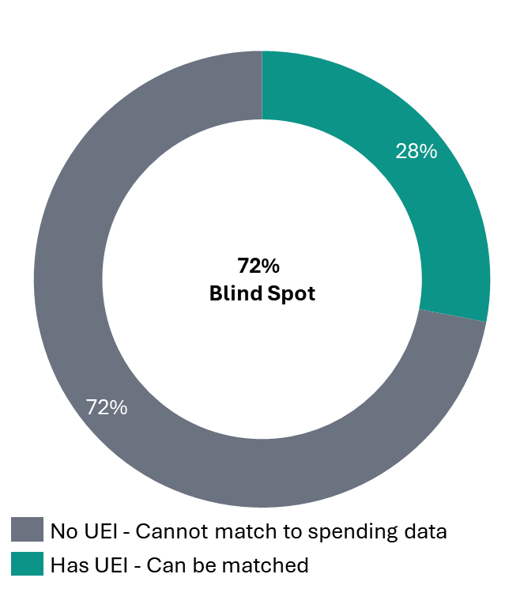
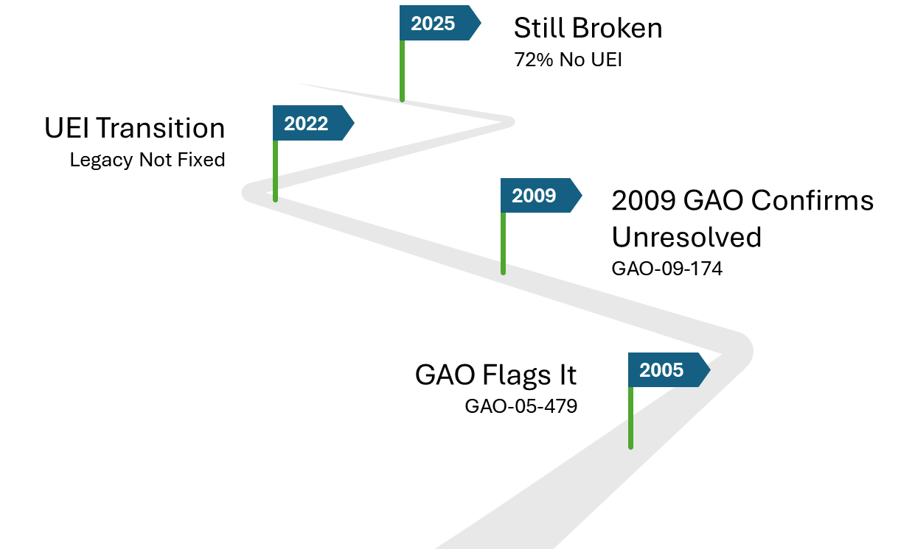
The 72% Blind Spot
We know who's excluded. We just can't tell if they're still getting paid.
Exclusion Data Snapshot
72% Untraceable
120,099 excluded entities have no UEI
Only 47,227 (28%) can be matched
GAO flagged this gap in 2005
GAO confirmed it was still unresolved in 2009
SAM.gov Exclusion Records
Documented Efforts
We can't track everyone. But we can show what happens when we do.
Fiscal Patriots | AGA Datathon 2026
Source: SAM.gov Public Extract 25361 (Dec 2025) | GAO-05-479 (2005) | GAO-09-174 (2009)

Slide 13
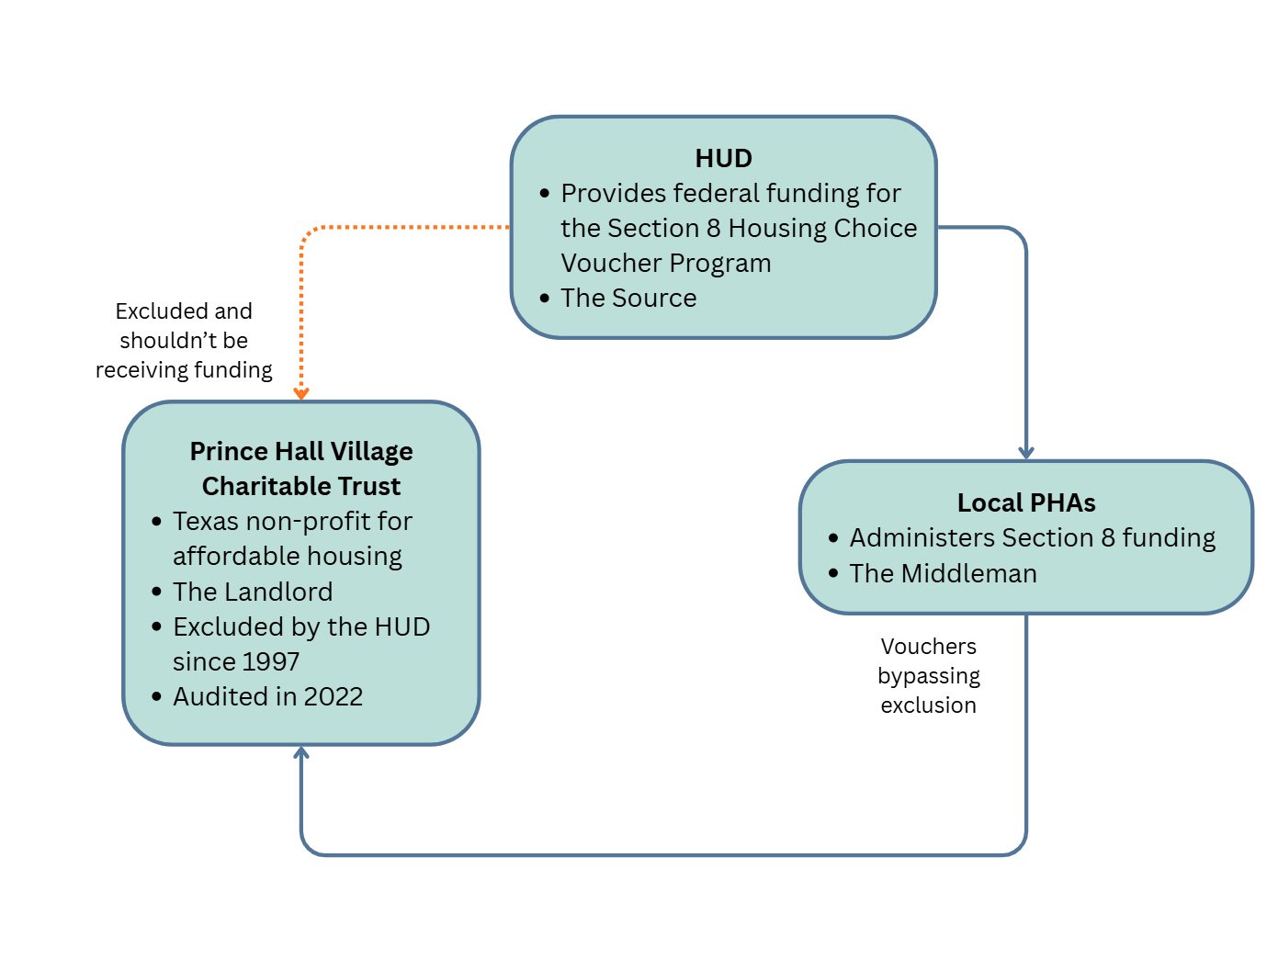
A Gap in the System
How HUD Paid an Excluded Entity for 28 Years
Key Players
What Went Wrong
The Gap
HUD permanently excluded the entity in 1997
Section 8 payments were not screened
PHAs relied on manual checks
Exclusion enforcement failed across decentralized systems
~$2M paid in Section 8 subsidies
Payments confirmed through 2022 audit activity
Failure persisted for 28 years
Without automated, pre-payment exclusion screening, permanent exclusions can be effectively ignored, even within a single agency.
A glaring inter-agency oversight
Add: Legal citation Add: This entity was traceable (28%) most aren't. Check if TPS score would have flagged this entity. - Add: TPS Score X%, proves our system would flag this.
Undermines federal payment integrity and public trust
Creates legal, financial, and reputational risk
Connected by UEI Unique Entity Identifier
Fiscal Patriots | AGA Datathon 2026
Source: USAspending.gov (FY2019-2024), FAC (FY2016-2024), SAM.gov Public Extract 25361 (Dec 27, 2025)

Slide 14
Banned by One Agency, Paid by Another
Cross-Agency Communication Failure
What Went Wrong
Key Legal Principles
Why This Matters
Entity: Amerihost Services, LLC
Excluded by EPA: September 8, 2021
Problem: Despite the EPA ban, HUD continued paying the entity for housing-related awards in FY2022–FY2024.
2 CFR § 180: Federal exclusions are binding across all agencies.
An exclusion by one agency (EPA) automatically applies to all other federal agencies, including HUD.
This is known as government-wide reciprocal effect.
2 CFR § 180.415(b)
Agencies cannot renew or extend transactions with an excluded entity unless an exception is documented.
15 payments over FY2022–FY2024 (5 per year) constitute renewals or extensions, prohibited without an exception.
Cross-agency enforcement gaps
Lack of automated screening for exclusions
Direct legal violations of federal regulations
Add: HUD paid $X to a legally excluded entity Check if TPS score would have flagged this entity. - Add: TPS Score X%, proves our system would flag this.
HUD paid a legally excluded entity, creating a cross-agency compliance failure.
Connected by UEI Unique Entity Identifier
Fiscal Patriots | AGA Datathon 2026
Source: USAspending.gov (FY2019-2024), FAC (FY2016-2024), SAM.gov Public Extract 25361 (Dec 27, 2025) | 2 CFR § 180.415(b)

Slide 15
ML Model - Pranavi
Altering model to predict material weakness specifically?
How can the model be used to predict whether a specific entity will have findings the next year?
Score = 100 – Risk Points (capped 0-100)
Assessment parameter
Risk Factor Rationale
Key Risk Factors
Going Concern (+25) | Auditor doubts entity can continue operating.
Material Weakness (+20) | Severe internal control failure.
Repeat Findings (+15) | Same problem year after year, the entity isn't improving.
Questioned Costs (+15) | Taxpayer dollars flagged as being used improperly.
Plus 7 additional factors weighted by severity (see appendix)
Mitigating Factors
Low Risk Auditee (-15) | Clean audit history, proven track record.
Corrective Action Plan (-5) | Entity responded to findings with an action plan.
Risk Tiers
🔴 High Risk (0-59). Multiple audit failures
🟡 Moderate Risk (60-79). Some concerns identified
🟢 Low Risk (80-100). Minimal findings, trusted
Fiscal Patriots | AGA Datathon 2026
Source: FAC (FY2016-2024) | Methodology: Fiscal Patriots
Notes:
Pranavi

Slide 16
Recommendations - Nikita
01
Closing the 72% Blind Spot
Require UEIs for all SAM exclusion records
Retroactively assign UEIs where feasible
02
Enabling Cross-System Verification
Automate pre-payment exclusion screening
Eliminate reliance on error-prone manual checks
03
Providing Clarity to Decision-makers and Tax-payers
Display audit history to awarding officials
Explore risk or trust scoring within USAspending.gov
The Bottom Line: Funding Data needs to provide exclusion visibility to multiple stakeholders in the system. This is where trust scores come become essential in decision-making and transparency.
Connected by UEI Unique Entity Identifier
Fiscal Patriots | AGA Datathon 2026
Source: USAspending.gov (FY2019-2024), FAC (FY2016-2024), SAM.gov Public Extract 25361 (Dec 27, 2025)
Notes:
Pranavi

Slide 17
Rollout Plan - Mariam
Fiscal Patriots | AGA Datathon 2026

Slide 18
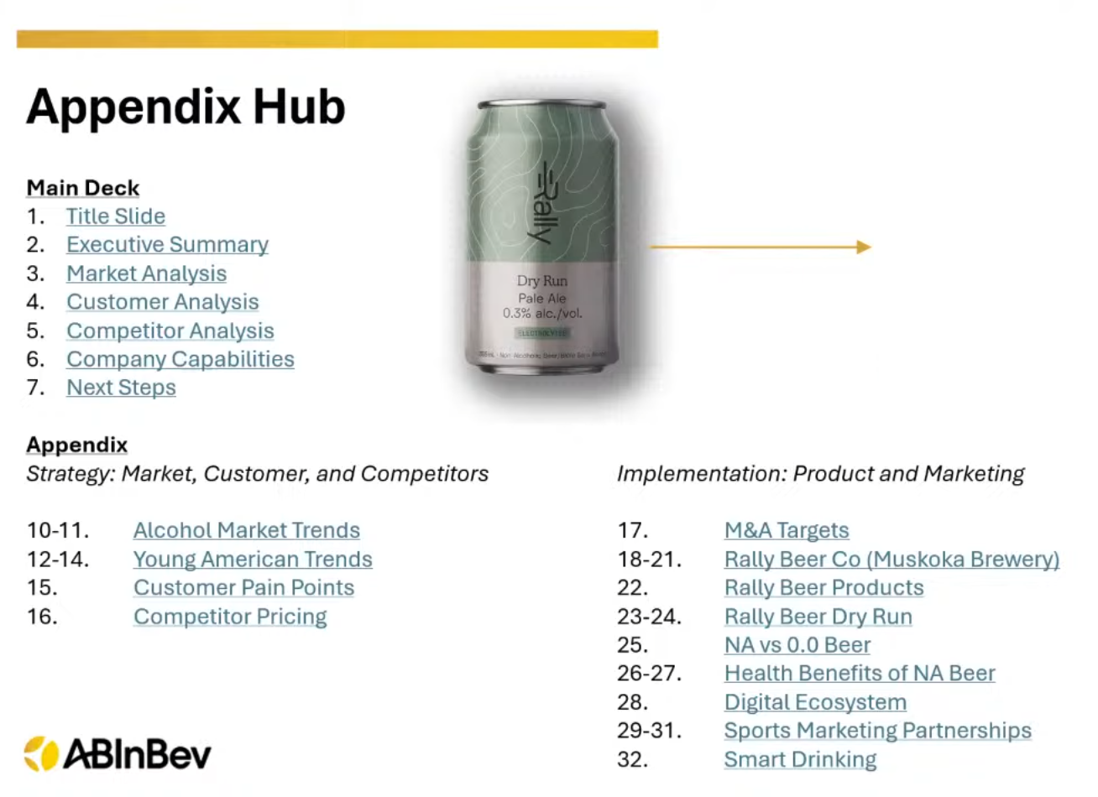
Appendix - Andy
FOR ANDY: Add links to key branches in our GitHub, organized under these categories: 1. DATA SOURCES
- USAspending.gov documentation
- SAM.gov Public Extract info
- Relevant Data Dictionaries
2. METHODOLOGY
- Alteryx workflow screenshots
- Data cleaning & join logic
- Entity matching approach
3. TAXPAYER PROTECTION SCORE
- Weighting rationale (full table)
- Variable definitions
- Score calculation formula
4. ML MODEL
- Feature importance chart
- Train/test split methodology
- Model validation metrics
5. REGULATORY CITATIONS
- GAO-05-479 (2005)
- GAO-09-174 (2009)
- 2 CFR 200 Subpart F references
6. CASE STUDIES (EXTENDED)
- Full audit findings for flagged entities
- Supporting documentation
Example
Fiscal Patriots | AGA Datathon 2026
Notes:
Pranavi

Slide 19
Appendix - Andy
DATA SOURCES
TAXPAYER PROTECTION SCORE
REGULATORY CITATIONS
USAspending.gov: API docs + data dictionary
Variable Definitions (fields used in scoring)
GAO-05-479 (2005) reference used
Federal Audit Clearinghouse (FAC): dataset overview + files used
Weighting rationale (risk factors vs mitigating factors)
GAO-09-174 (2009) reference used
SAM.gov Exclusions: public extract documentation (UEI coverage limitation)
Score formula and tier thresholds
2 CFR 200 Subpart F references (audit requirements)
"Allowable Data Sources " (competition rules screenshot / doc)
"Problem Entity" rule (logic and flags)
Any additional compliance/audit standards referenced in analysis
Data dictionaries used in this repo (FAC, USAspending, Merged outputs)
Final scoring outputs (tables produced for dashboard
METHODOLOGY
ML MODEL
CASE STUDIES (EXTENDED)
Pipeline overview (Clean --> Score --> Merge) visual
ML training dataset build workflow
Full audit findings for flagged entities (supporting tables)
Join logic: UEI mapping (auditee_uei = recipient_uei) explanation
Train/test split methodology
Example drill-down: one Red entity (risk drivers + funding)
Alteryx workflows (screenshots + the .yxmd files
Feature list + feature importance chart (or placeholder if not done
SAM exclusions cross-check examples (when UEI matches exist
Data acquisition notes (what we downloaded, and why)
Model validation metrics
Supporting documentation: screenshots/tables used in the write-up
Outputs and how to reproduce them (inputs to outputs mapping )
Final ML-ready outputs
Fiscal Patriots | AGA Datathon 2026
Notes:
Pranavi

Slide 20
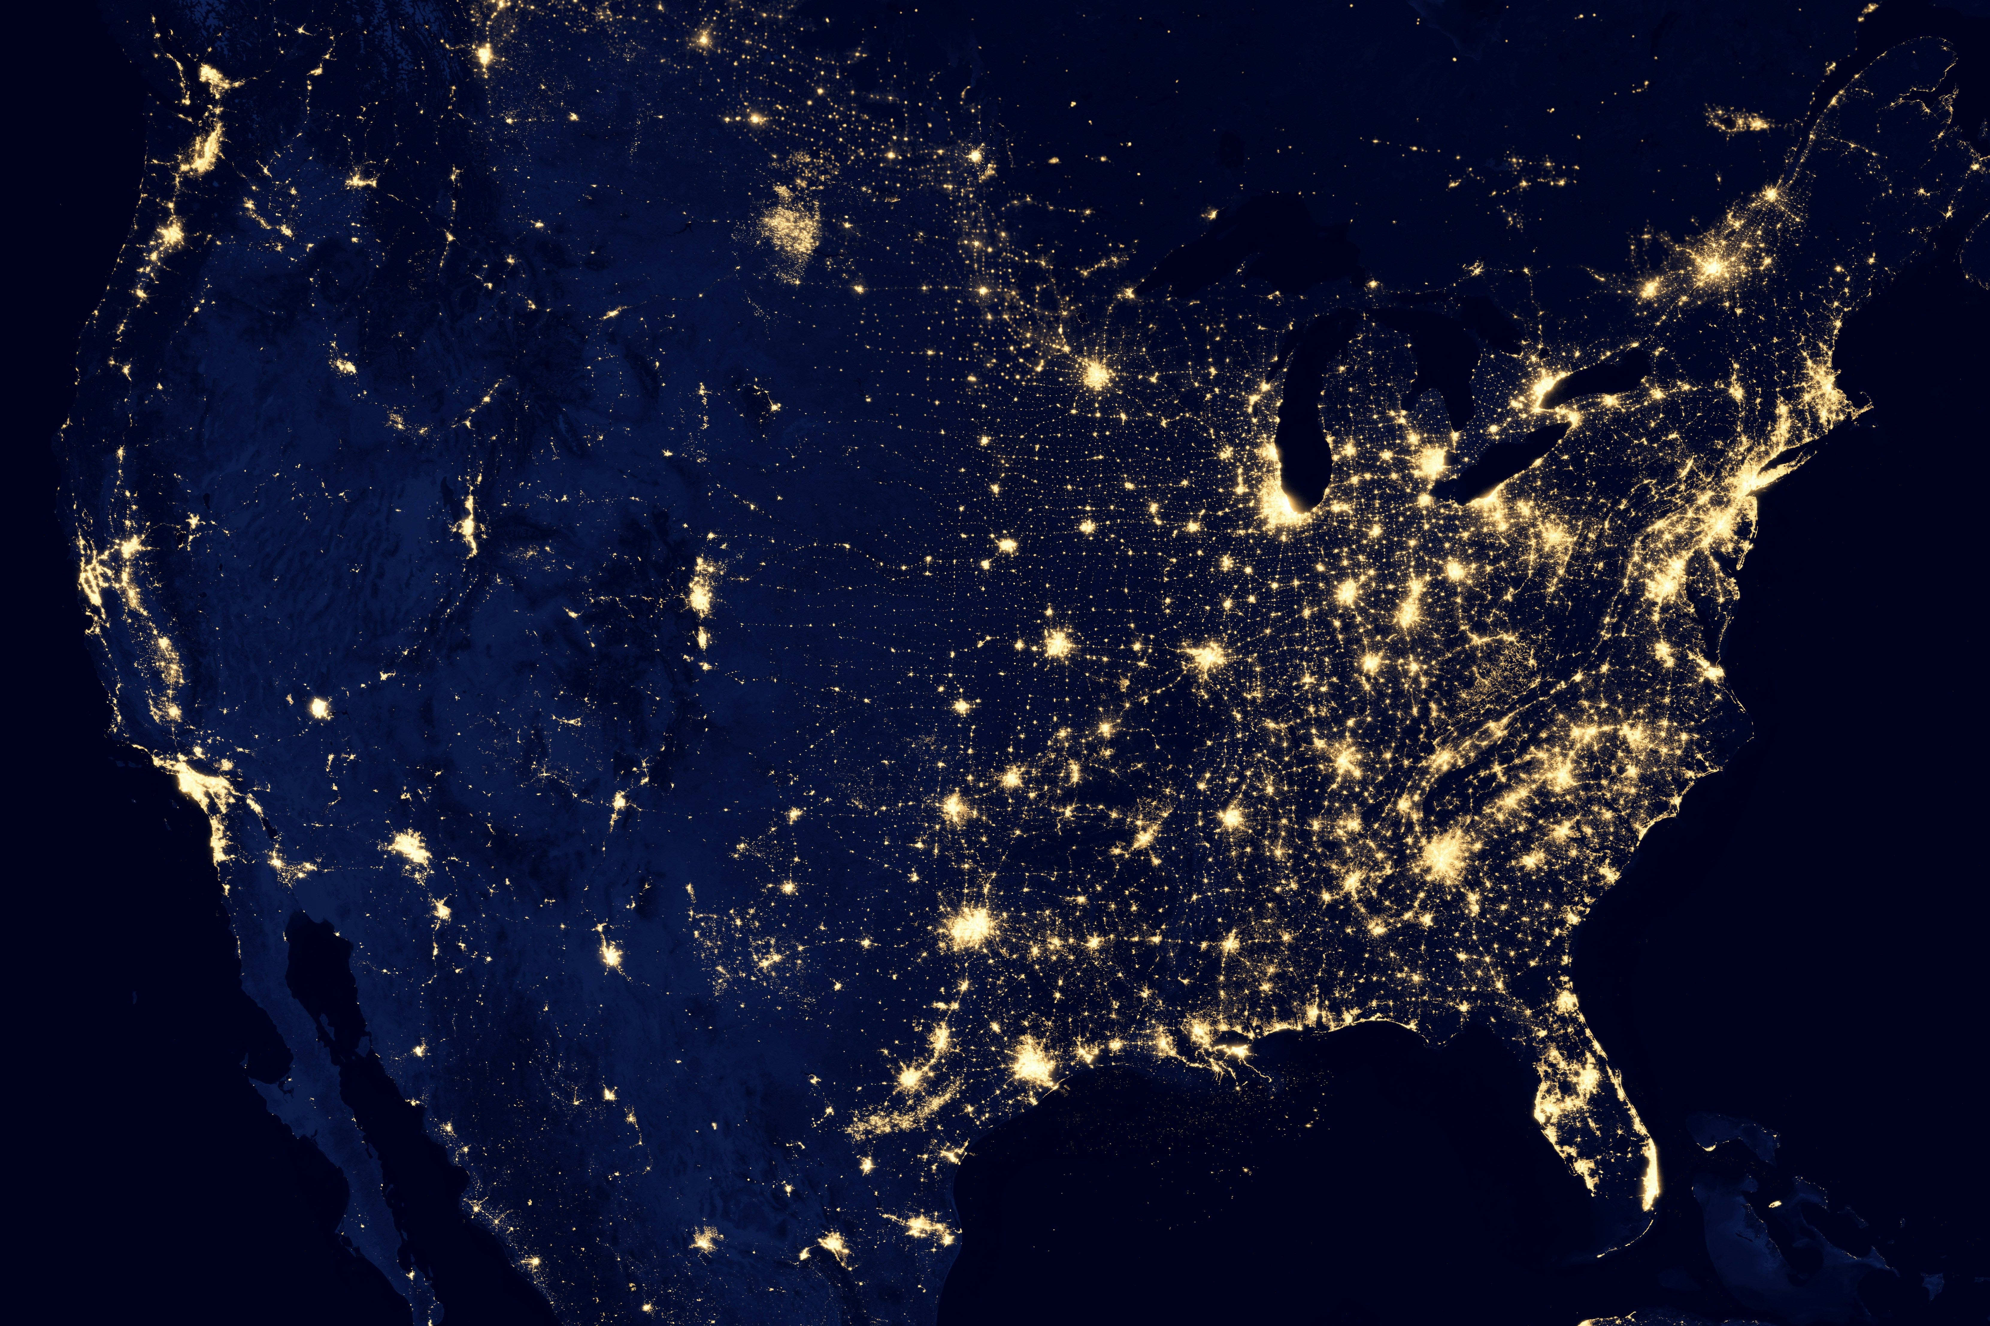
Thank you

